Slide 1
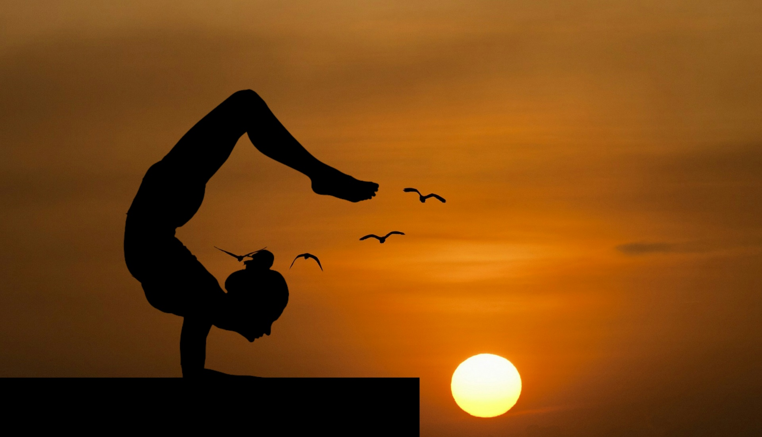
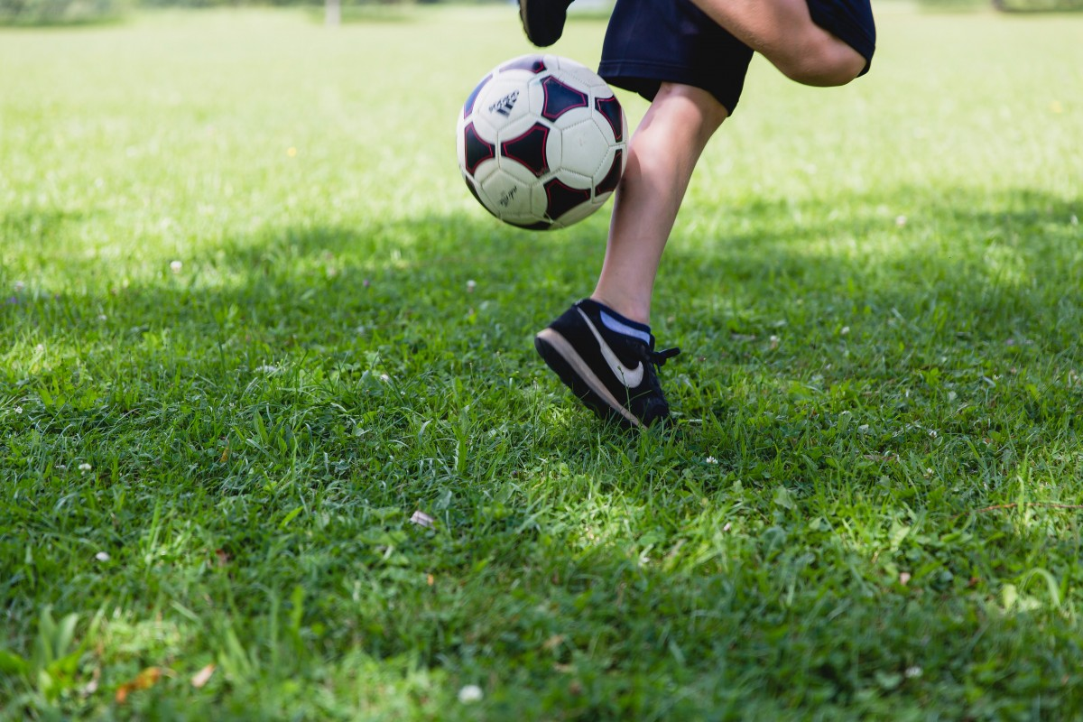
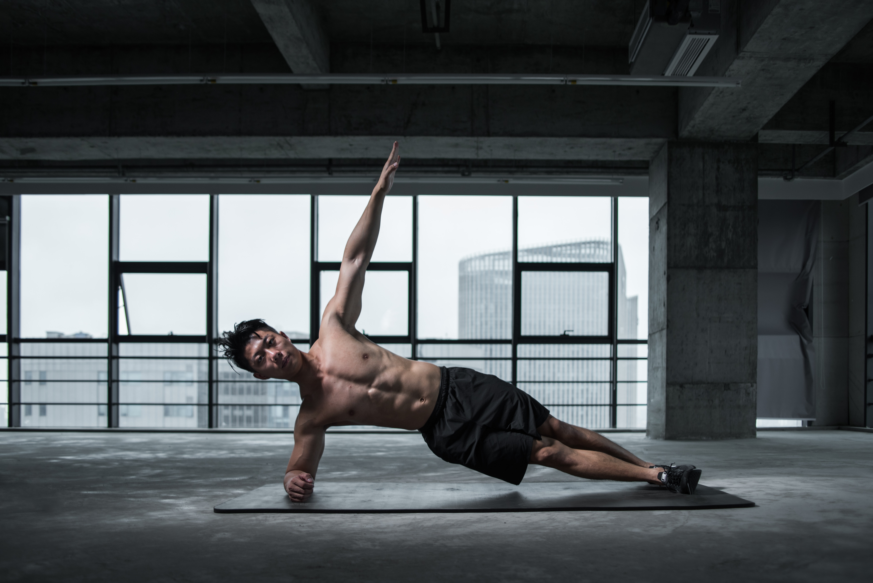
Importance of physical activities

Slide 2
What is physical activites
Physical activity is any bodily movement that uses your muscles and requires more energy than resting. It can include any movement you do throughout the day, except for sitting or lying down.

Slide 3
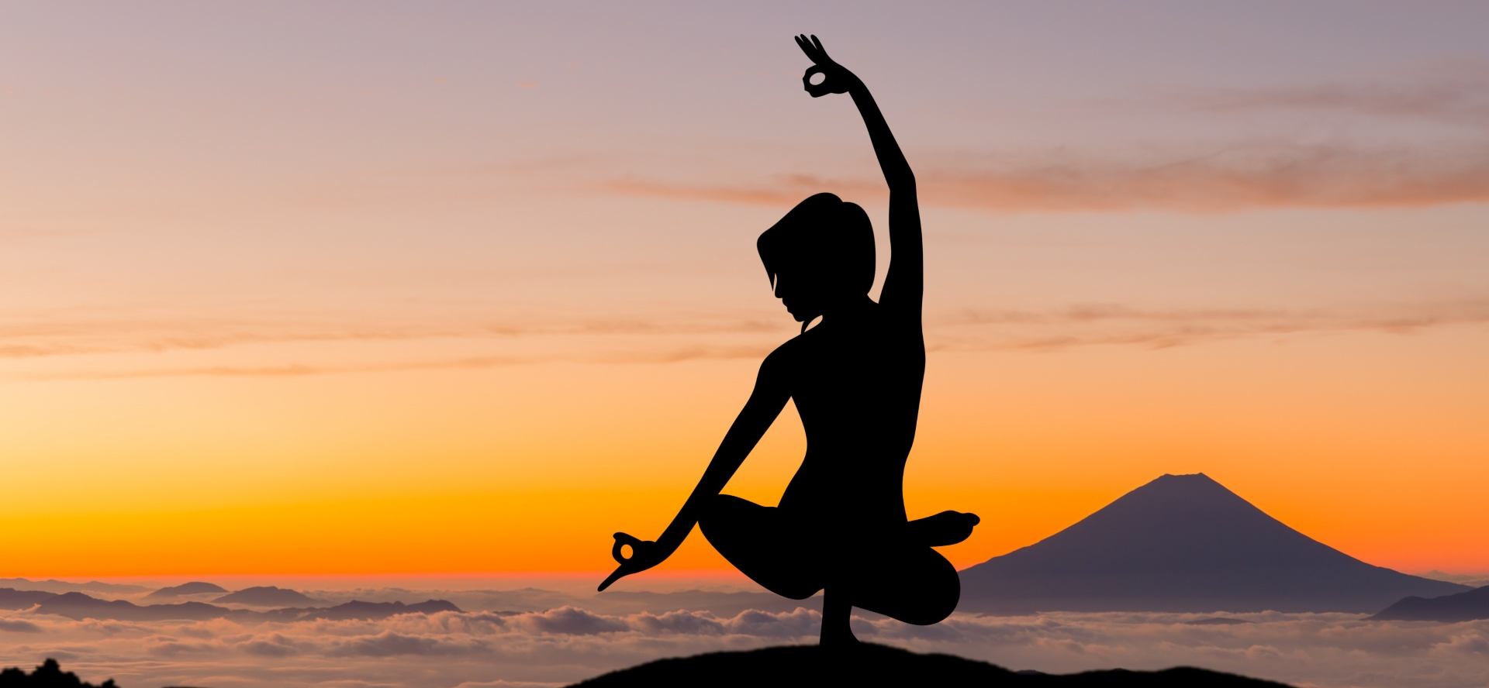
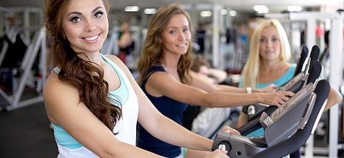
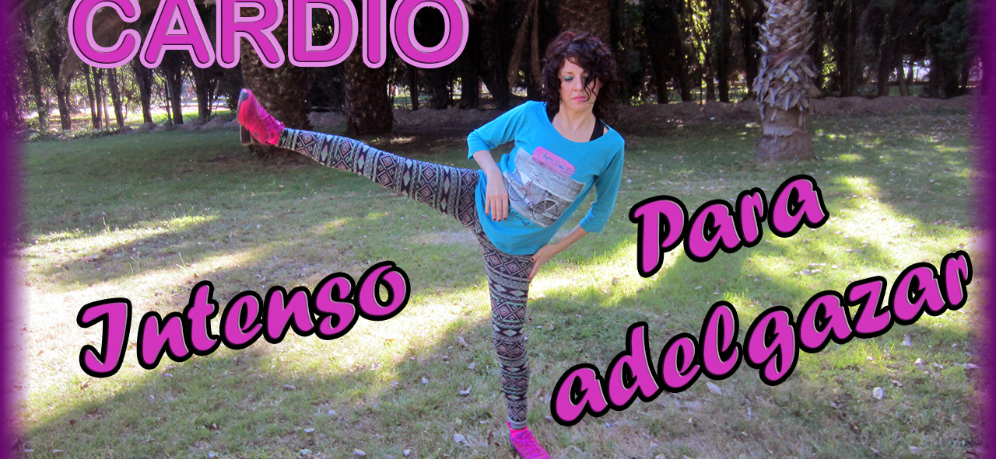
Different types of physical activities
yoga
gym
cardio

Slide 4
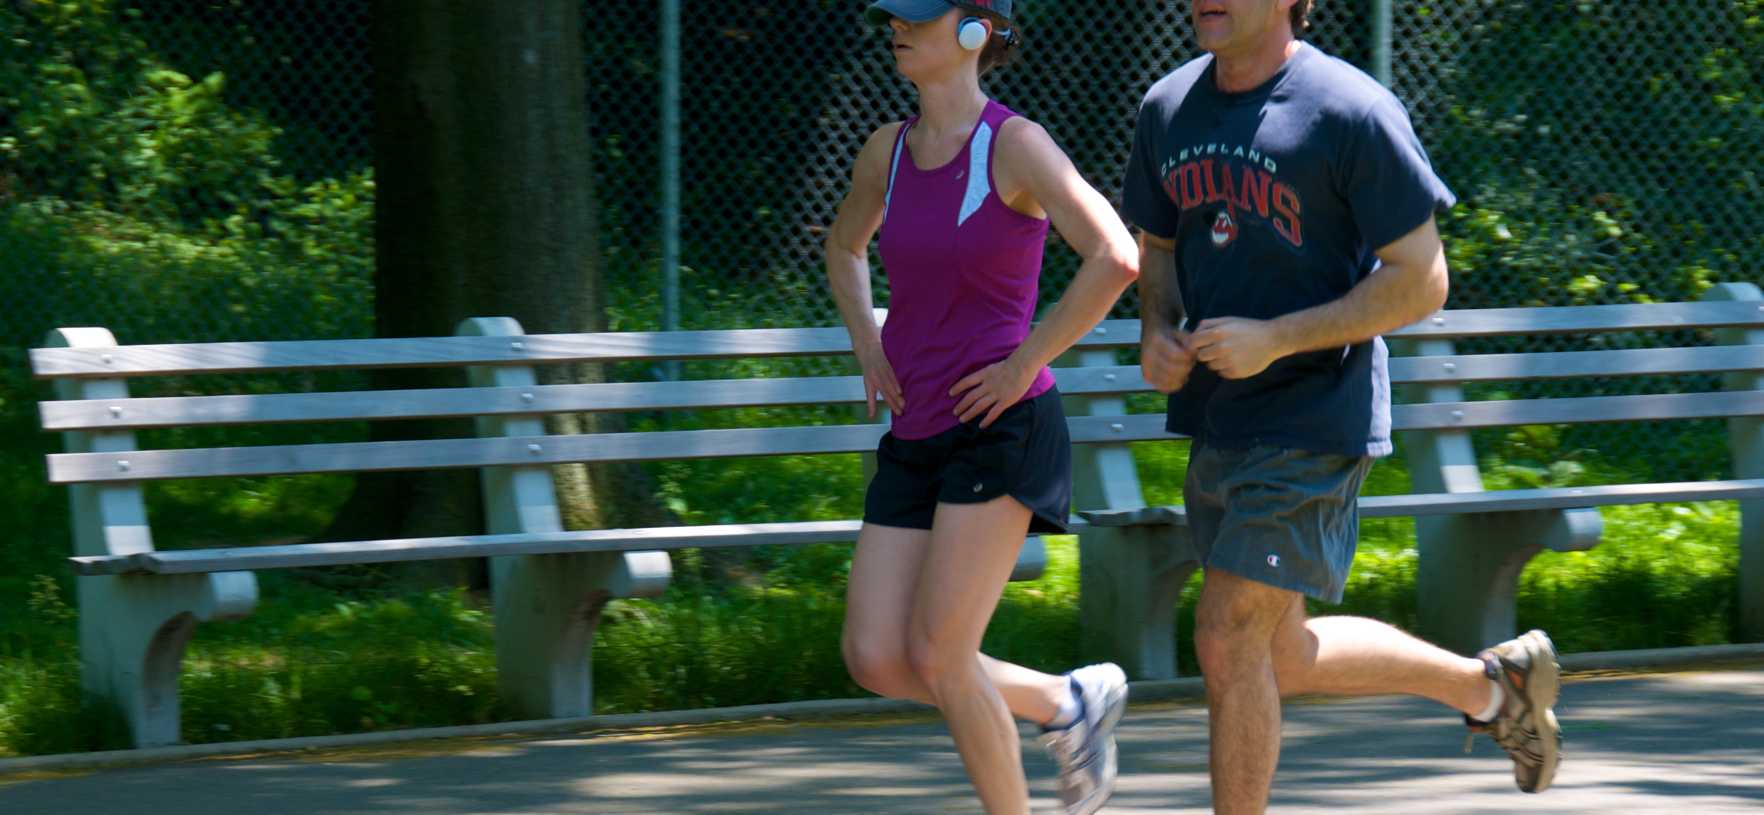
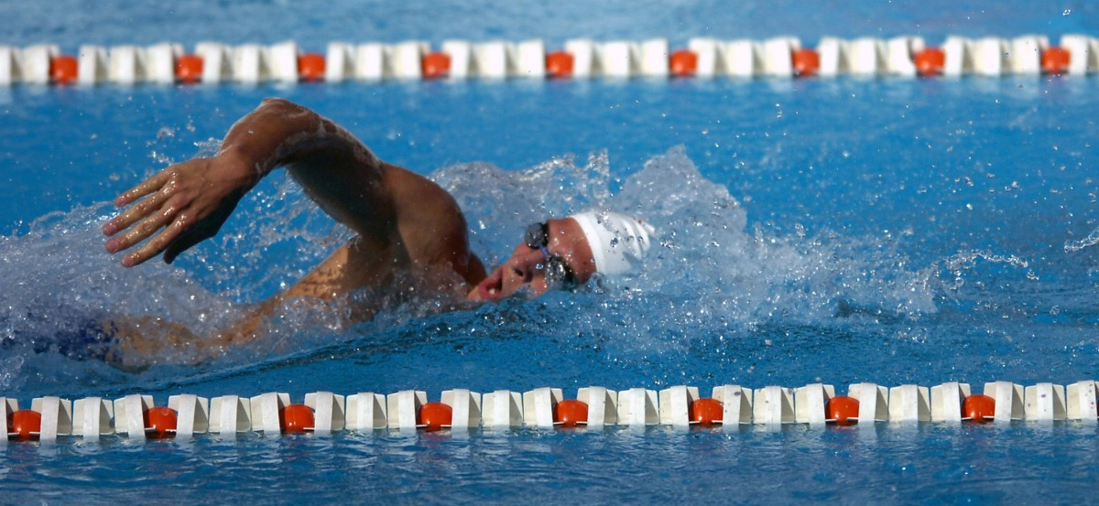
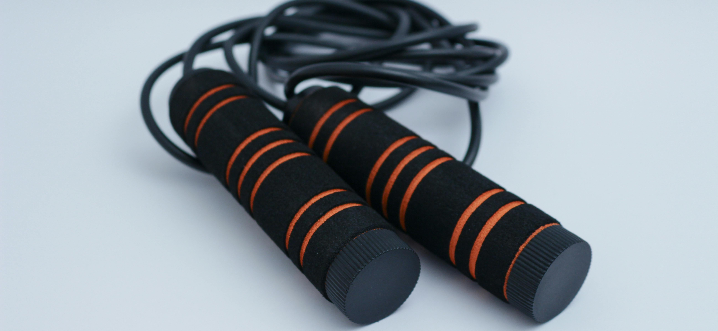
jogging
swimming
skipping

Slide 5
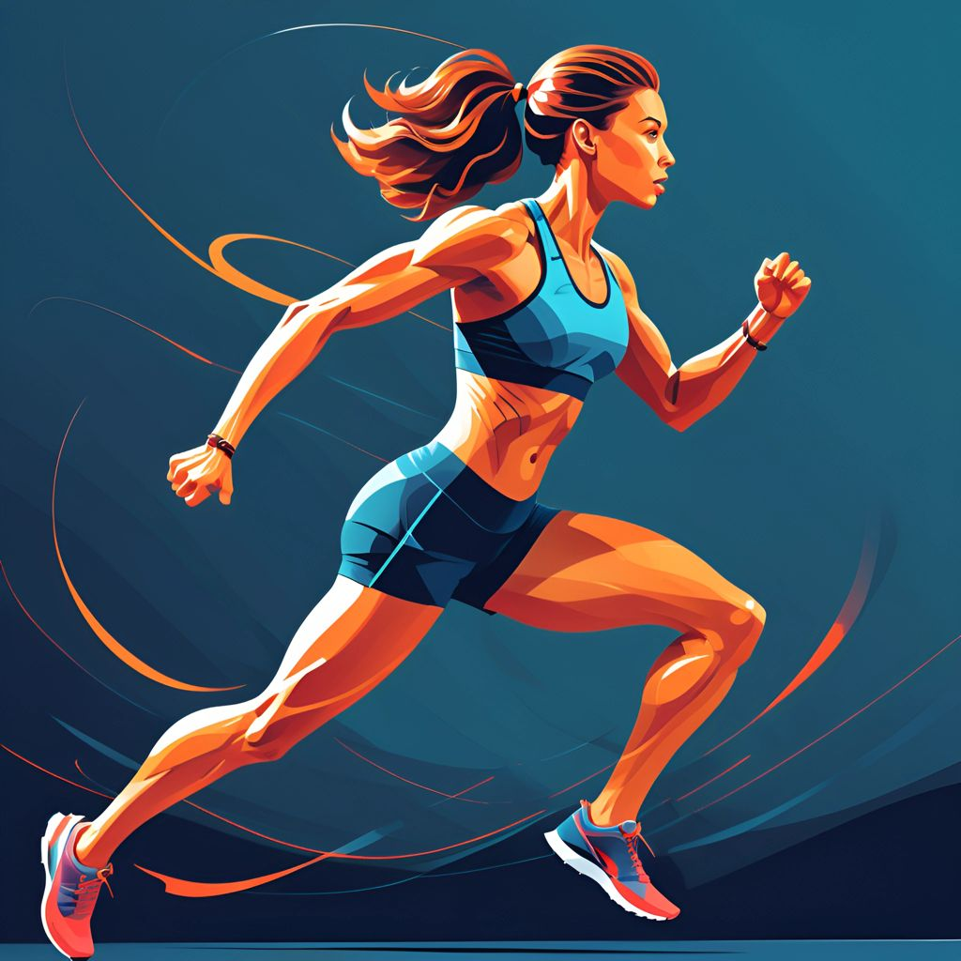
The benefit of regular activity
Strengthen bones and muscles
Improve heart and lunch function
reach or maintain a healthy weight

Slide 6
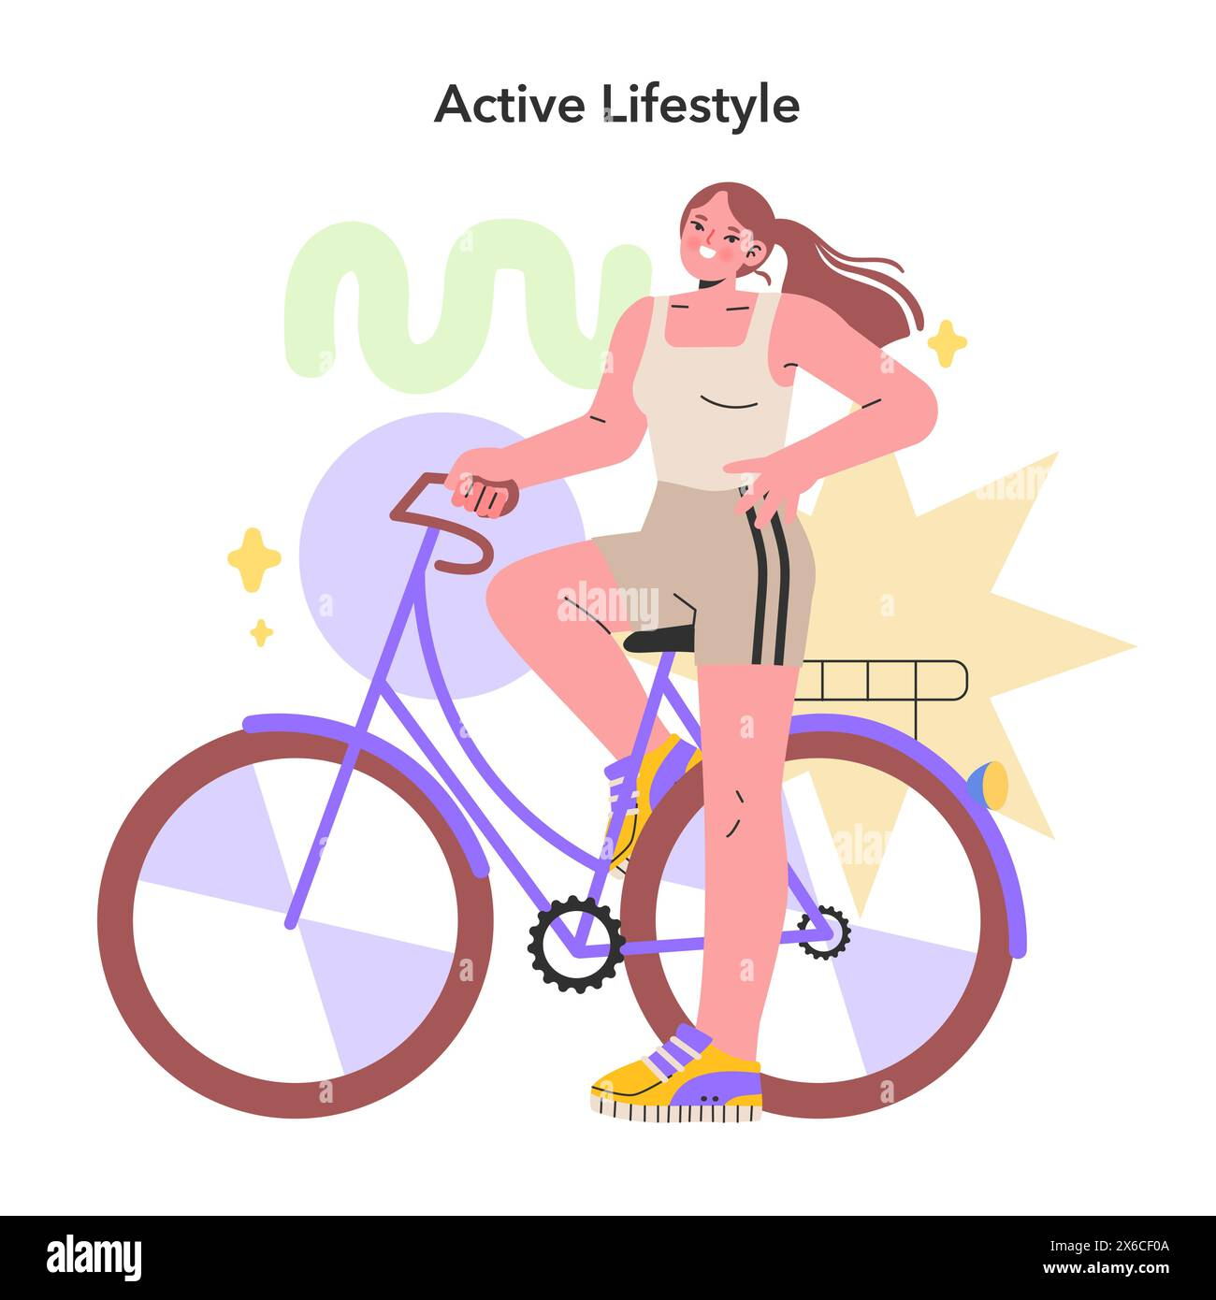
Sleep better
Feel happier
Feel productive

Slide 7
For leading a healthy life as well as we need to do physical activities we need to drink water sufficiently go to bed early and wake up early finally a discipline life can give you a healthy life healthy environment

